Slide 1
Introduction to Vue.js
Raymond Camden

Slide 2

Who am i?
Raymond Camden
Developer Evangelist at HERE
Blogging at raymondcamden.com
Tweeting at raymondcamden

Slide 3
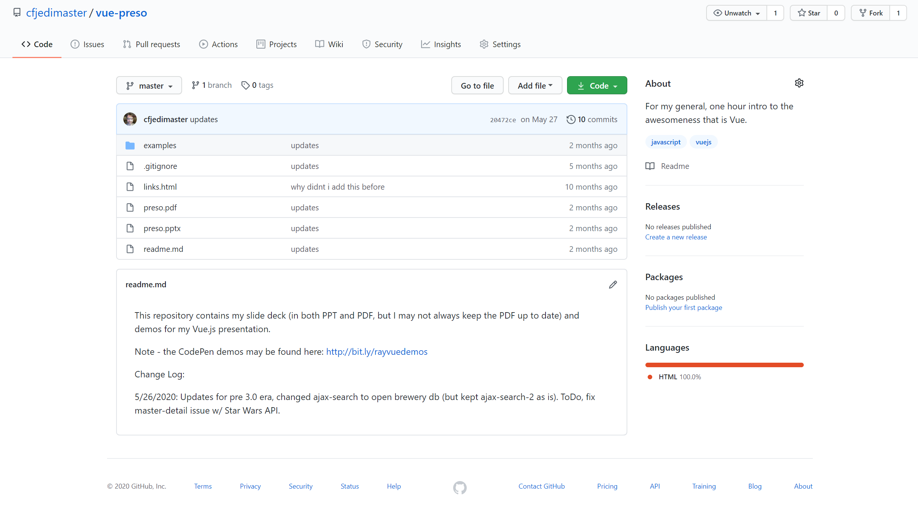
https://github.com/cfjedimaster/vue-preso

Slide 4

Why Vue?
Notes:
vue vs vue.js

Slide 5
Let’s back up…
Notes:
Do we need a framework?
Yes.
Helps decide where shit goes.
Helps manage complexity

Slide 6
Why Vue?
Notes:
vue vs vue.js

Slide 7


SIMPLE
Notes:
Approachable

Slide 8

No Build Process
Notes:
Easy to add to existing sites

Slide 9

Scalable

Slide 10

Quick Vue Facts
Created by Evan You (@youyuxi)
Released in February of 2014
Currently is version 2.6.11
Main site: vuejs.org
GitHub: https://github.com/vuejs

Slide 11
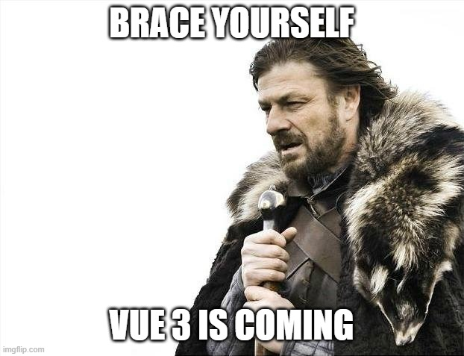

Slide 12
Vue 3.0
When?
Really soon now! (RC)
What?
More later!
Where?
https://github.com/vuejs/vue-next

Slide 13
What does vue do?
Two-way binding between your DOM and JavaScript
Template Language (aka Declarative Rendering)
And I know I said this - but it does more. A lot more.
Notes:
Let me stress - VUE DOES MORE THEN THIS! When I start learning something I will intentionally ignore things that I think I'm not quite ready for yet, so when I first started, Vue did two things for me.
Two-way binding - not terribly exciting but really useful. So if I want to put a form field on a page and know when it changes, or I want to set it based on some condition or an Ajax load, Vue makes that easy.
By template language (and the docs call it Declarative Rendering), I basically have a way of saying that if I have a JS variable called name and the value is ray, I want to show that on the page. That's not terribly exciting, but it goes very deep. Instead of a simple variable name I could have an array of names. Vue has a way to render that. WHat if name was empty of not yet defined? Vue provides conditionals. So if you've ever used or heard of Jade (now called Pug), Handlebars, Mustache, etc, than Vue has this baked in.

Slide 14

Installation
npm install
cli install
Download from site
Copy and paste a script tag FTW!!!!!1!

Slide 15
<script> Style
<script src="https://unpkg.com/vue"></script>

Slide 16
Write SOme Code!
Identify where you're going to render stuff
Setup some data
Render that data
Add events (ie on this do that) and other fancy stuff

Slide 17




Willy Nilly DOM Manipulation
$('#somediv').html('woot');
$('#someotherdiv').val(2);
$('#yetanotherdiv').html('<b>This is awesome</b>');

Slide 18
Defining Vue's Place...

Slide 19

Examples
http://bit.ly/rayvuedemos

Slide 20
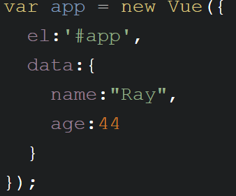
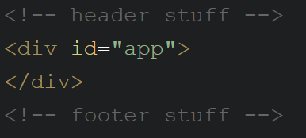
Some code...

Slide 21
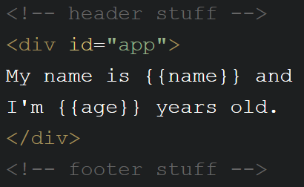
Some MORE code...

Slide 22
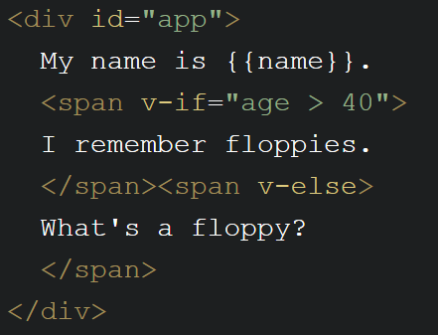
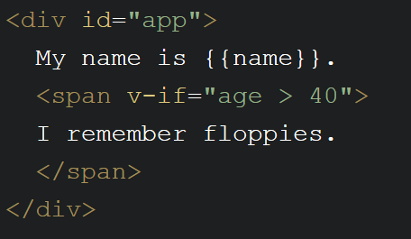
Template Directives - Conditionals
Notes:
code pen

Slide 23
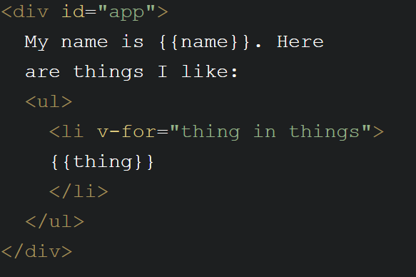
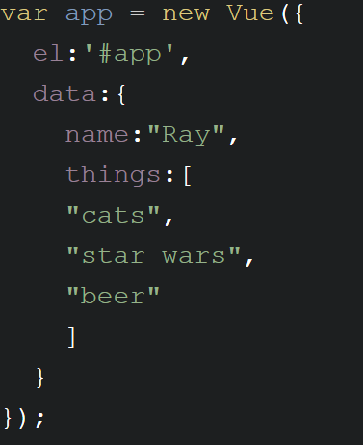
Template Directives - Loops
Notes:
code pen

Slide 24
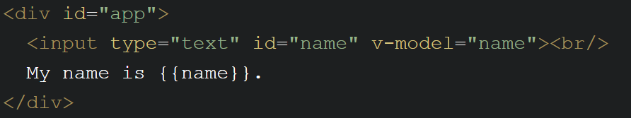
Working with Form Fields
v-model links to data field
Works in all kinds of form fields
https://www.raymondcamden.com/2020/01/27/vue-and-form-fields

Slide 25
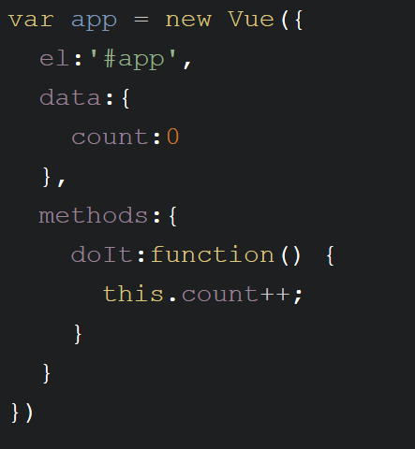
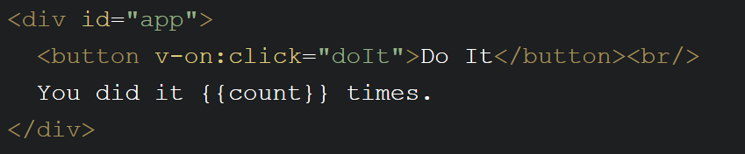
Events
v-on:click=“something”
Defined in methods block of Vue instance
Easy to do modifiers (v-on:submit.prevent)
@click=“something”

Slide 26
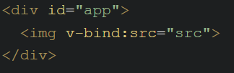
Attribute BInding
v-bind:attribute=“value”
:attribute=“value”
v-bind:style="{bgcolor:curColor, font-style:textStyle}"
v-bind:class="{highlighted:isActive, color:appStatus}"

Slide 27
Computed Properties
Virtual properties
Property X is based on real data A and B
Defined in the computed part of the Vue instance

Slide 28
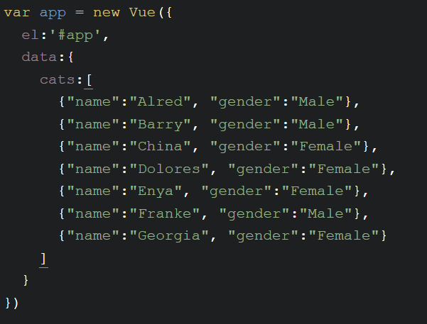
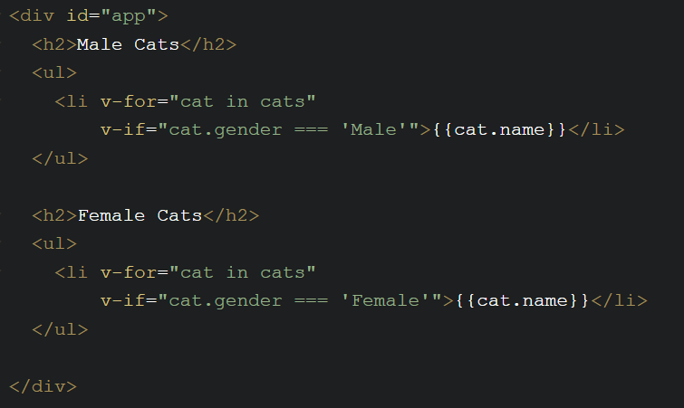
Example (Before)

Slide 29
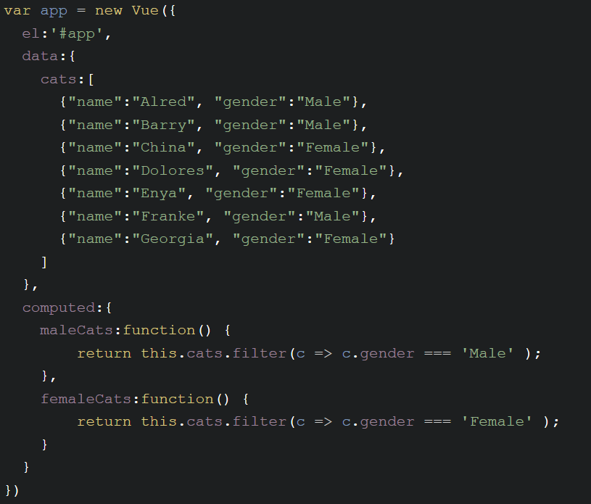
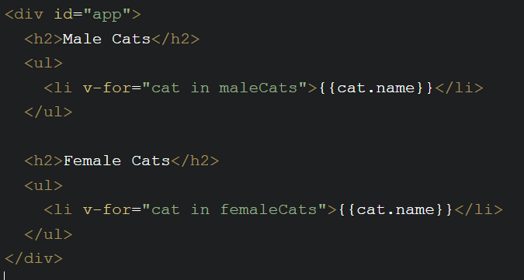
Example (After)
Notes:
demo app.cats.push

Slide 30
Vue Lifecycle Events
Events that occur while a Vue instance is doing stuff
beforeCreate, created, beforeMount, mounted, beforeUpate, updated, activated, deactivated, beforeDestroy, destroyed, errorCaptured
https://vuejs.org/v2/api/#Options-Lifecycle-Hooks

Slide 31
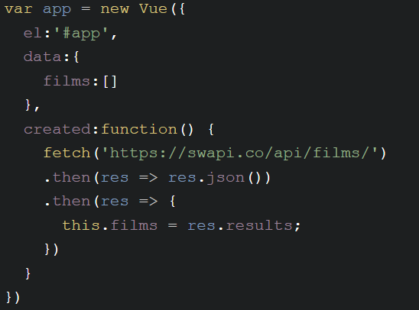
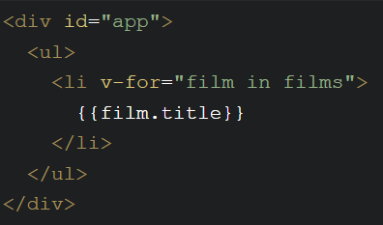
Example

Slide 32
Filters
Allow you to define a "formatter" for a value
{{ birthDate | formatDate }}
v-bind:something="someValue | changeValue"
Chainable: {{ birthdate | makeMeNotOld | formatDate }}
Arguments: {{ birthdate | formateDate('short') }}

Slide 33
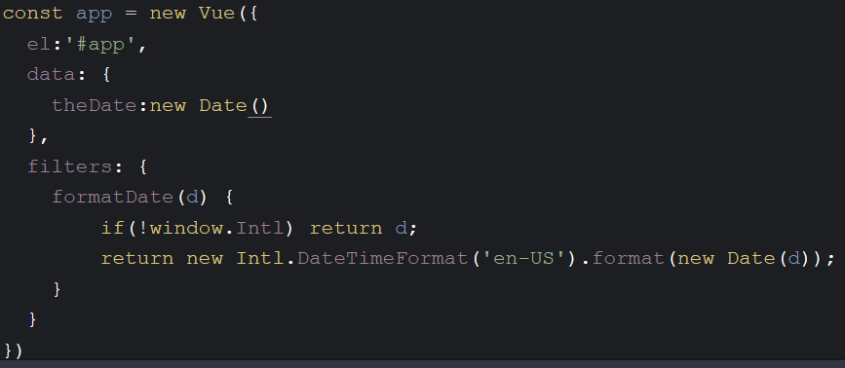
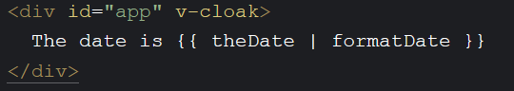
Example

Slide 34
Quick Tip
Hiding the FOUC (Flash of Unstyled Content
Add v-cloak to DOM item "holding" your app
Add a style declaration to hide it.

Slide 35
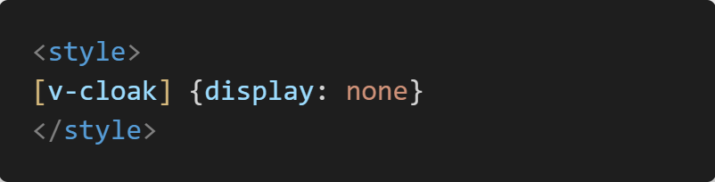
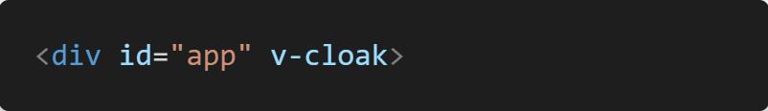

Slide 36
Full Example: Form Validation
Do I need to explain this?
Check on submit, report on top
More examples: https://vuejs.org/v2/cookbook/form-validation.html

Slide 37
Full Example: Ajax Search
Accept user input
Send to remote API...
https://www.openbrewerydb.org/documentation/03-search
Render responses

Slide 38
Components
Re-usable objects of awesome-ness
Template + Logic + Style = Component
Also solves one of HTML's most glaring problems...

Slide 39

<kitten>

Slide 40
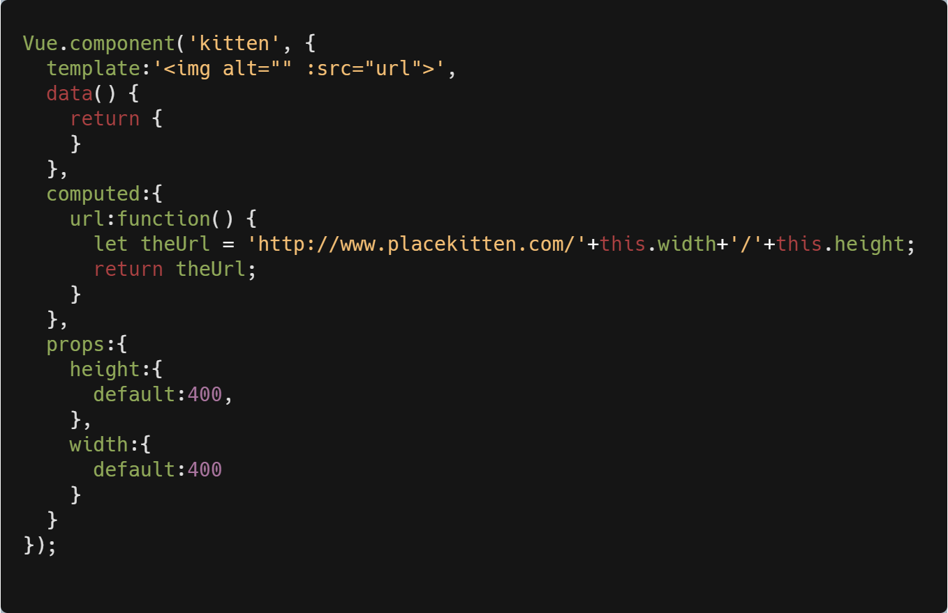
Example

Slide 41
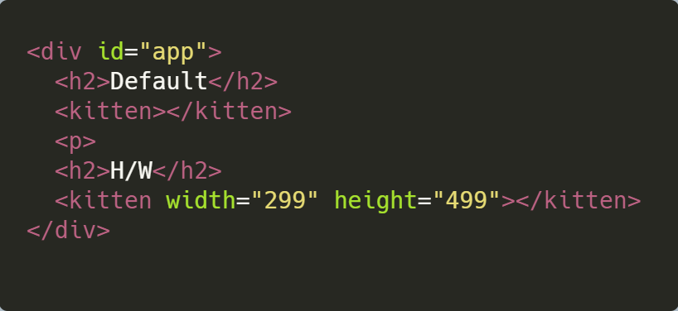
Example

Slide 42
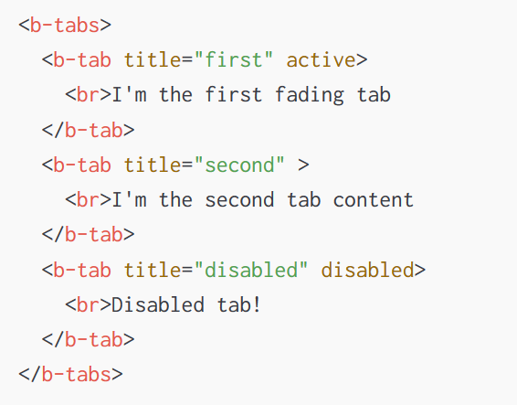
Component Examples
Google Static Maps: https://www.npmjs.com/package/vue-static-map
Bootstrap: https://bootstrap-vue.js.org/
Vuetify: https://vuetifyjs.com/en/

Slide 43
More Component Stuff
You can pass data in from the parent
You can listen for events from the component
"Sub children" (Slots)
<mything>
<template v-slot:thankyou>
Hey, I want to <i>really</i> thank you for taking
the time to do whatever. We here at Mega Corp truly
care that you took the time. Oh, and here, please
take a kitten!
</template>
</mything>

Slide 44
Full Example: Placeholder
Create an <image-placeholder> tag
Use placeholder.com (or any other service)
Accept height and width (with defaults)

Slide 45


Slide 46
The CLI
Scaffolding tool
Focused on SPAs (but also does prototyping well)
https://cli.vuejs.org
Supports Single File Components

Slide 47
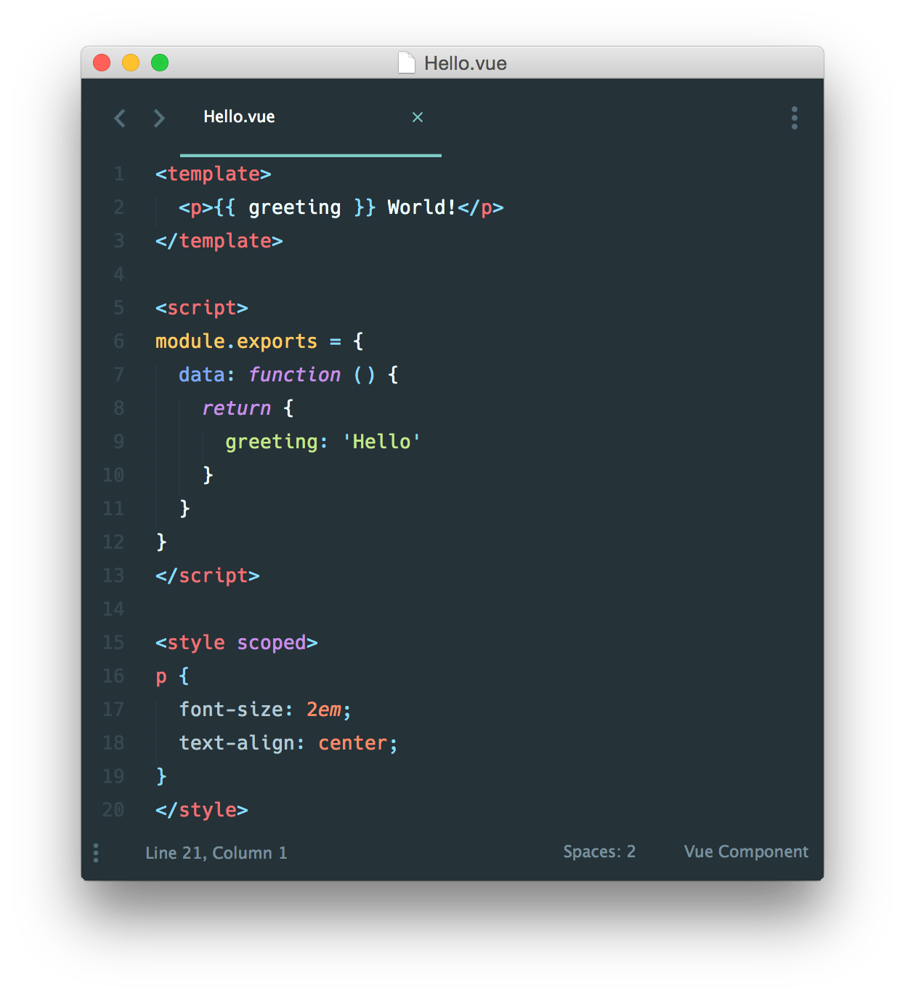
Single file Components

Slide 48
Walkthrough
FYI, install via: npm i -g @vue/cli
Then: vue create foo
Or: vue serve (with App.vue)

Slide 49
Routing
Not a part of Vue
Official library: vue-router (https://router.vuejs.org)
Maps URL paths to components
Supports dynamic paths

Slide 50
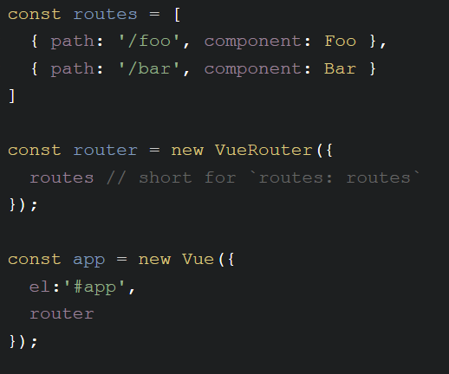
Example (From the Docs)

Slide 51
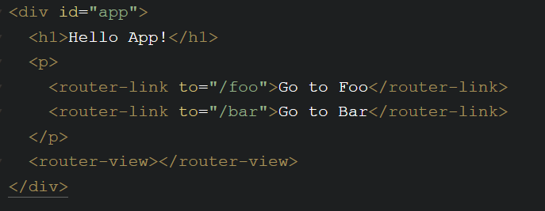
Example (Still from the docs)

Slide 52
Full Example: MaIN/Detail
First page - list of data
Second page - detail

Slide 53
State Management
Solves a problem you may not have!
One component, one set of data = easy
Two components, two set of data = mostly easy
Many components, one set of data = um....

Slide 54
Vuex
(Another) library for Vue (deeply integrated)
"Store"
Components can read from the store
Components cannot change data in the store (directly)

Slide 55
Vuex – Learn More
https://vuex.vuejs.org/

Slide 56
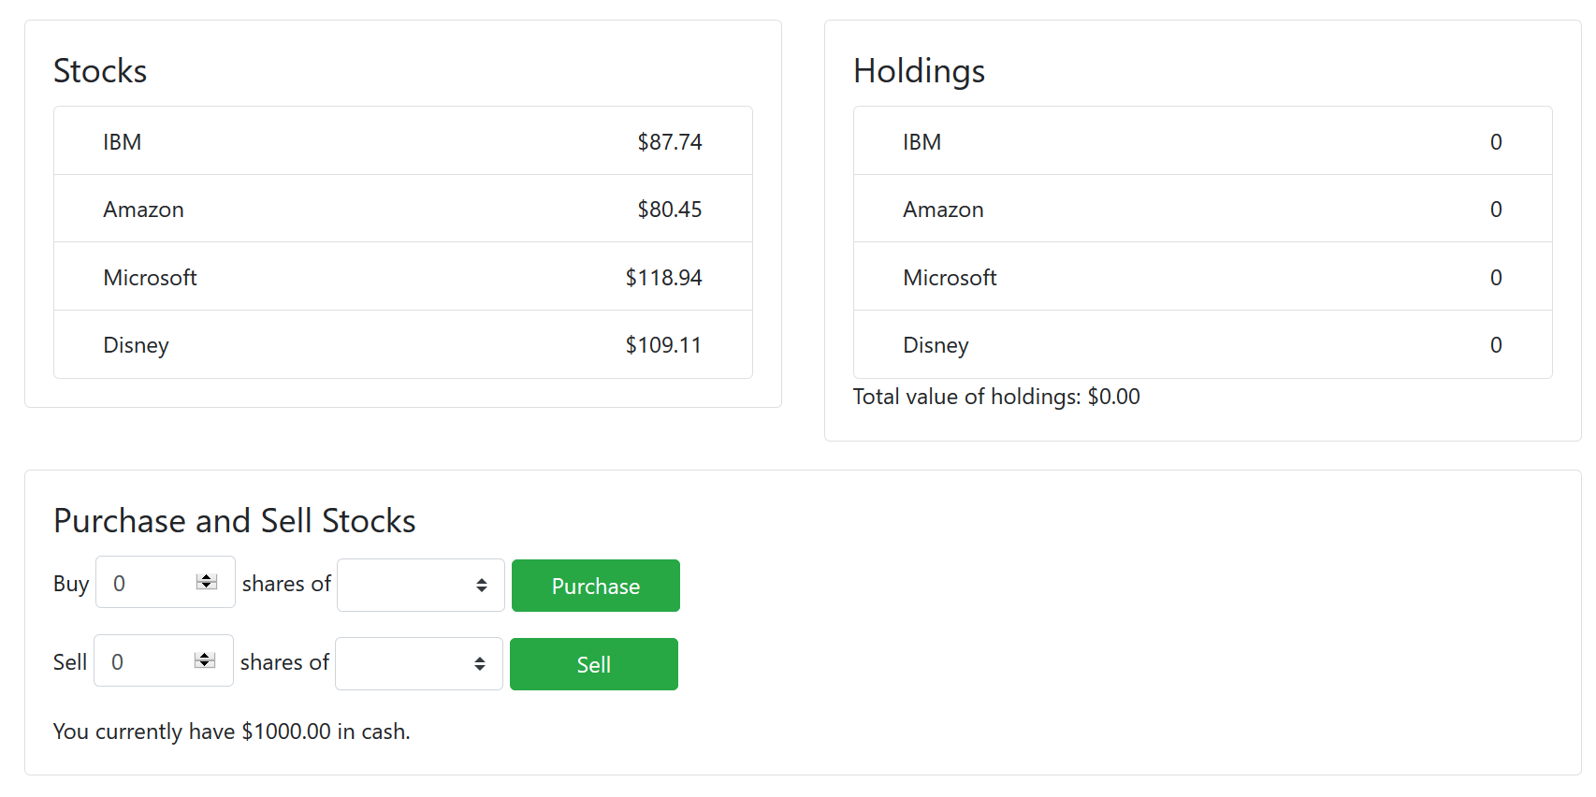
Vuex Example

Slide 57
3.0 - What's next?

Slide 58
Vue 3.0
Faster, smaller
Virtual DOM rewrite, native Proxy, 100% faster component instance initialization
20kb to roughly half (gzipped)
Multiple v-model support
<MyThing v-model:rank="userRank" v-model:title="userTitle" />
Suspense
Fallback support (ie, show this while loading)
Portals
Render content elsewhere, uses a <Teleport> tag

Slide 59
Vue 3.0
TypeScript Support
Vue itself - all in TS
No need for "wrapper" divs in template blocks (aka "Fragments")

Slide 60
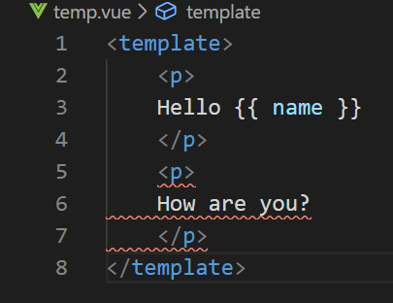
Vue 3.0

Slide 61
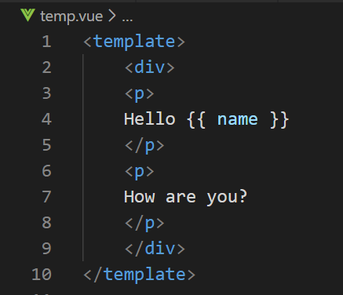
Vue 3.0

Slide 62
Vue 3.0

Slide 63
Vue 3.0
TypeScript Support
Vue itself - all in TS
No need for "wrapper" divs in template blocks (aka "Fragments")
Mounting changes to global libraries (add stuff to your Vue app, not global Vue object)
Composition API
OPTIONAL new way of writing components
Better for larger, complex architectures
Official repo: https://github.com/vuejs/vue-next

Slide 64

VUE 3 - RIP
Filters (deprecated)
render function (changed)
Event Bus (deprecated)
Photo by Charles Deluvio on Unsplash

Slide 65
Vue 3.0 - Learn MORE
Dan Vega on Vue 3 - https://www.youtube.com/watch?v=HmdKqXP8JR8
Upgrade guide - https://dev.to/blacksonic/the-vue-3-upgrade-guide-4dc4
Roundup - https://madewithvuejs.com/blog/vue-3-roundup

Slide 66

But wait – there’s more!

Slide 67
Even MOAR!!!
Devtools Extension (Chrome, Firefox, Electron, Safari)
https://github.com/vuejs/vue-devtools
Sarah Drasner on CSS-Tricks: https://css-tricks.com/intro-to-vue-1-rendering-directives-events/
Vue docs has a cool cookbook: https://vuejs.org/v2/cookbook/
Newsletters:
https://news.vuejs.org
https://vuejsdevelopers.com/newsletter/
My Stuff: https://www.raymondcamden.com/tags/vuejs
Notes:
Show example of the devtools extension

Slide 68
Stuff I didn't cover
Unit Testing (https://vuejs.org/v2/guide/unit-testing.html)
Transitions (https://vuejs.org/v2/guide/transitions.html)
Custom Directives (https://vuejs.org/v2/guide/custom-directive.html)
More....

Slide 69

Any questions?

